Slide 1
CUSTOMER CHURN RATE REPORT
CHURN ANALYSIS

Slide 2
Project Overview
This is a customer churn analysis.
Churn refers to the leaving/ defaulting of customers from a company.
The above project was done in TABLEAU PUBLIC software with the help of EXCEL.
The aim of the project was to understand why and when are customers leaving and what can be done to reduce the same.
The results are summarized in an interactive and Dynamic tableau dashboard.

Slide 3
About the dataset
The dataset is a churn dataset from Kaggle
The dataset represents the churn of customer for a certain internet Service Providing company based in California, USA.
It shows the churn information of the various cities in California.
The dataset contained 16 different but related tables namely: Billing, Churn_Category, Churn_Category_Reason, Churn_Reason, Contract, Customer, Customer_Churn_Category, Customer_Feature, Customer_Status, Dependancy, internet_Service, internet_Service_Feature, Location, Marital_Status, Phone_Service, Payment, Service_Plan.

Slide 4
Skills Demonstrated In The Project
Data cleaning
Data transformation
Data analysis
Data visualization
Critical thinking
Drawing insights from data
Microsoft Power Point presentation skills

Slide 5
Steps Carried Out In The Project
Data Cleaning and Transformation in EXCEL.
Data Visualization in TABLEAU PUBLIC.
Presentation in POWER POINT

Slide 6
Data Cleaning and Transformation in Excel
The dataset contained 16 tables which had to be combined into a single dataset.
I used the DUPLICATE FUNCTION to remove all the duplicate records.
Using the XLOOKUP FUNCTION and the CUSTOMER TABLE as a base table, I was able to fetch data from the other tables to form a complete dataset with the required metrics.
Used IF ERROR FUNCTION to modify the records that did not get a match after the look up.
Used filters to eliminate blanks and other inconsistencies in the data set.
The clean dataset had 44 fields and 7031 records.

Slide 7
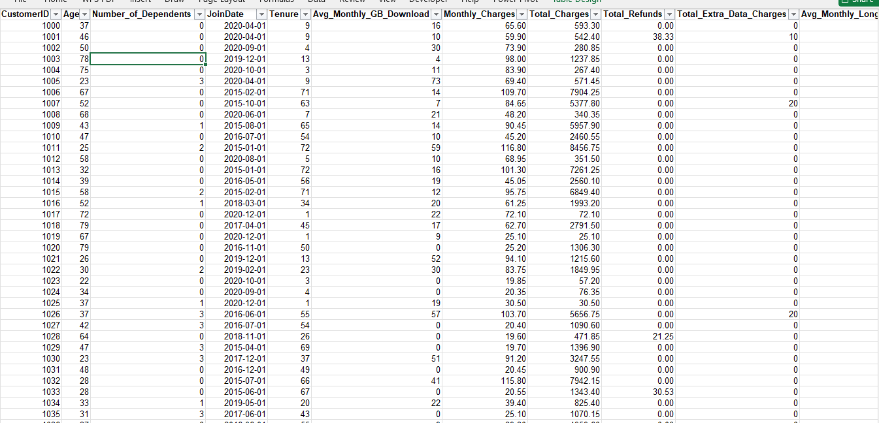
Clean Dataset Snapshot

Slide 8
Data Analysis
Here, I came up with Key performance Indicators(KPI’s) tailored towards Churn Analysis. These KPI’s will help identify factors contributing to customer churn and guide strategies for improvement.
I used Exploratory Data Analysis (EDA) to slice through the data and address the concerns arising from the KPI’s.
The result, I summarized in an interactive and dynamic tableau dashboard.
Below are the KPI’s and their significance when it comes to Churn Analysis.

Slide 9
Key Performance Indicators(KPI’s)
Churn Rate:- This is the percentage of customers who left the service within a specific period. This is the primary KPI for measuring customer retention. Understanding churn rate trends can help identify periods of high attrition.
Average Tenure Of Customers:- This is the average duration customers have been with the service. Longer tenure typically relates to customer loyalty. Analyzing tenure can help identify at risk customers nearing the end of their contracts.
Satisfaction Score:- This a measure of customer satisfaction, often derived from surveys or feedback. High satisfaction is generally associated with lower churn rates. Monitoring this score can help identify service issues before they lead to churn.

Slide 10
Key Performance Indicators(KPI’s)
Monthly Revenue Per User(ARPU):- Average revenue generated per customer per month. Understanding ARPU can highlight revenue growth opportunities and inform pricing strategies.
Effect Of Billing Type On Churn:- Analysis of churn rates based on billing methods(paper vs paperless). Insights here can help optimize billing processes and enhance experience, reducing churn.
Average extra data charges:- This is the average monthly extra charges incurred by customers. High extra charges may lead to dissatisfaction and churn. Monitoring this can help identify customers who might benefit from different plans.
Churn By Customer Segment:- Refers to churn rate broken down by demographics (age, marital status, location). Understanding which segments have higher churn rates can help tailor customer retention strategies.

Slide 11
Data Visualization
I loaded the dataset into Tableau Public software.
I used the various charts and visualization techniques which best depicted the desired results.
Also I generated some CALCULATED FIELDS using VARIOUS FUNCTIONS to cater for the missing links in the dataset.
Finally, I added some STYLING and FORMATTING to the charts to make them visually appealing.
The outcomes are summarized below.

Slide 12



1.Churn Rate
I created a calculated field by dividing [Total churned Customers] by [Total Customers] and getting the percentage.
The results showed that 38.8% of customers have churned in a span of 5 Years.
2.Monthly Revenue Per User(ARPU)
I used the following formula to get the ARPU
The result show that ARPU is $97.77

Slide 13
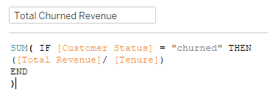

3.Total Monthly Churned Revenue.
I used a SUM FUNCTION and IF STATEMENT as shown below
The result showed that the company loses an income of $37.2K monthly due to customer churn.

Slide 14
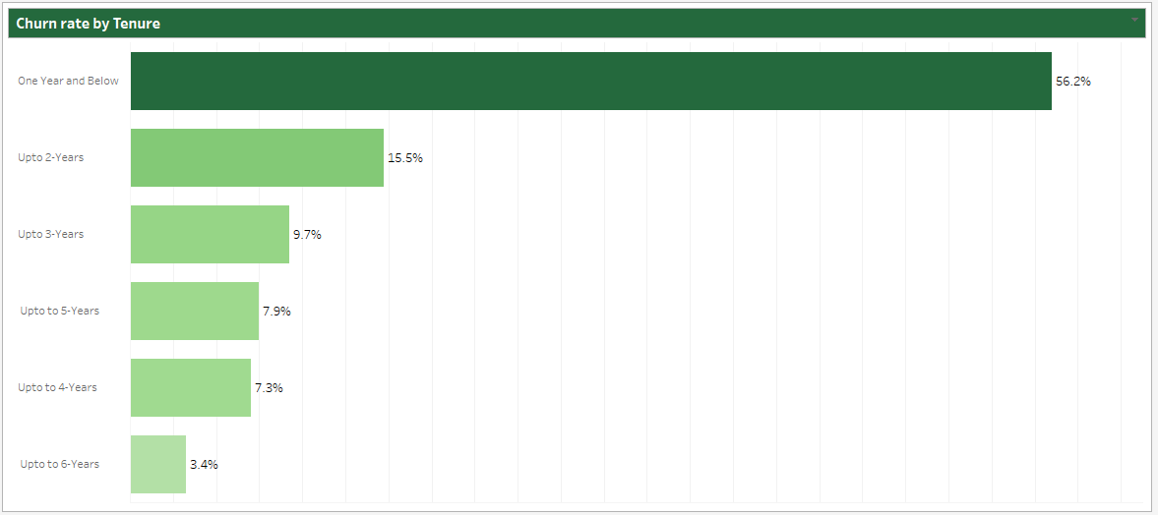
4.Tenure Of Customers
Using the numerical tenure values, I created groups with a one year interval to represent the churn rate by the period the customer has been with the service.
The results showed that the longer the tenure of the customers the less the rate of churn.
The results were as shown below in the bar chart.

Slide 15
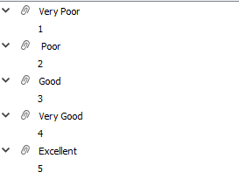
5.Satisfaction Score
Using the given satisfaction scores of between 1 and five, I came up with the following group
I created a pie chart to reperesent the results
The results showed that 48% of churned customer complain of VERY POOR SERVICE delivery , 26% say the service delivery is POOR while the remaining 26% say the service delivery was GOOD.
The results were as shown below

Slide 16
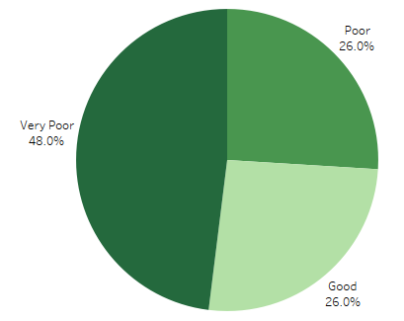
5.Satisfaction Score

Slide 17
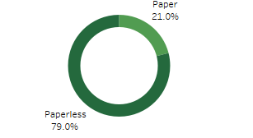
6.Effect Of Billing Type On Churn
Created a simply pie chart and converted into a doughnut chart since there Is no pre made doughnut chart in Tableau.
The result showed that 79% of churned customers use paperless type of billing while the remaining 21% use paper type of billing.
The results were as shown below

Slide 18
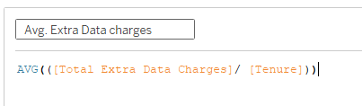
7.Average Extra Data Charges
Used the average function to calculate the average monthly extra data charges using the following formula.
Then grouped the charges into 3 categories of customers namely CHURNED, JOINED and STAYED.
The result showed that joining customers had the highest average extra charges per month of $1.35.
The following pie chart shows the outcome.

Slide 19
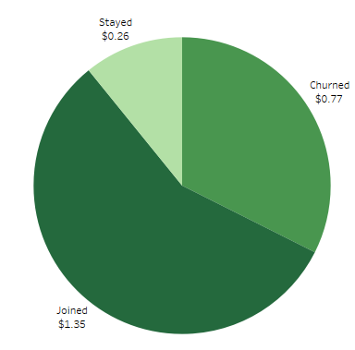
7.Average Extra Data Charges

Slide 20
Churn By Customer Segment
In this section, I used similar techniques as the ones I used on the other KPI’s.
This includes creating doughnut charts from pie charts, bar charts as well as calculated fields
This section includes churn by the following factors; Churn by Internet Service, By Contract Type, Churn by Phone Service Type, Churn by Service Plan, Churn by Payment Method, Churn rate By Cities, Reason For Churn.
The results were summarized as below.

Slide 21
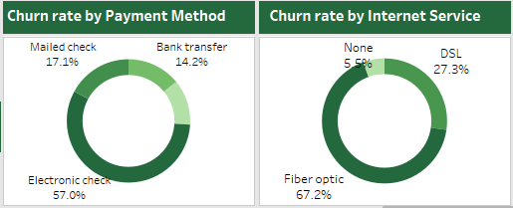
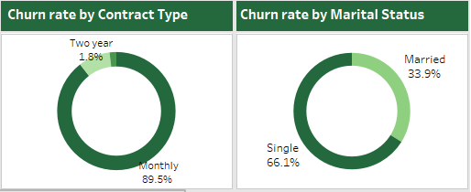
Churn By Customer Segment

Slide 22
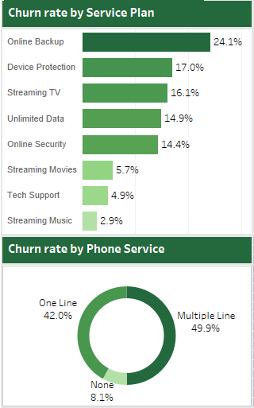
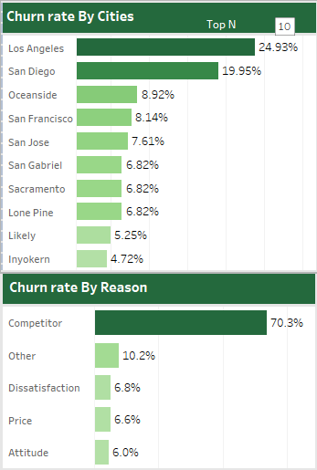
Churn By Customer Segment

Slide 23
Churn By Customer Segment - Conclusions
The rate of churn is higher for customers who use electronic check as payment method compared to other payment methods.
The churn rate for customers that use fiber optic is the highest at 67.2% compared to DSL which is at 27.3%.
The customers with a monthly plan tend to churn more compared to customers with longer period contracts.
Customers who are not married tend to churn more often than married customers.
Customers that use internet services for heavy tasks such online back up and device protection have a high tendency of churning compared to customers with other uses.

Slide 24
Churn By Customer Segment - Conclusions
Customers residing in the cities of Los Angeles and San Diego have a higher churn rate compared to those from other cities in California.
Customers with a phone service have churned more than those without.
Most customers have churned due better services offered by competitors of the company.

Slide 25
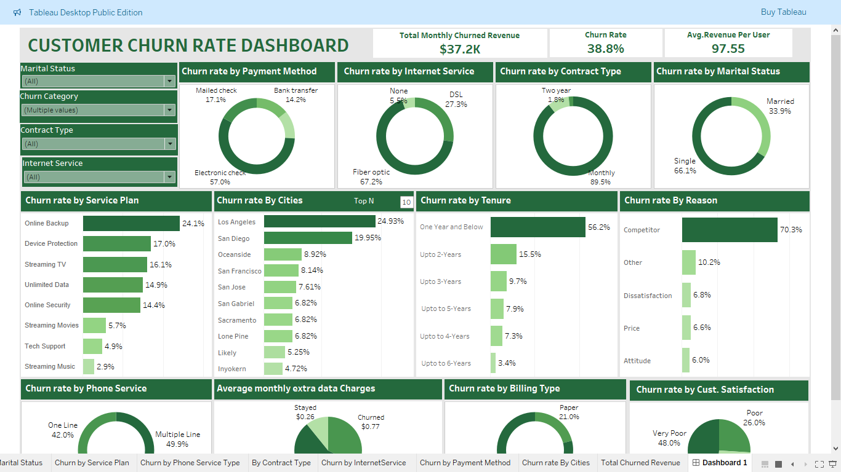
Dashboard Overview

Slide 26
Recommendations
The company should put an extra effort on recently acquired customers and prioritize their demands to help in customer retention and reduce churn.
The company should improve service delivery in terms of attitude of personnel who deal with customers to boost customer satisfaction hence reduce the churn rate.
The company should check on the billing type they use on customers. Majority of churning customers use the paperless billing which could be a problem to the customers.
The company should strive to enroll customers on longer period contracts since shorter period customers have a high tendency of churning.
The company should introduce cheaper plans to cut on the $97.55 monthly cost to reduce customer expense so as retain more customers.

Slide 27
Recommendations
The company should provide a better payment alternative for customers that pay using electronic check or convince them to use the other payment options available at the company since such customers have the highest churn rate when it comes to payment method category.
The company technicians should analyze and determine the cause of the high churn rate in fiber optics and DSL internet service types. And further improve the effectiveness of the services to reduce churn.
The company should create custom internet packages and plans that best suit customers marital status(Single vs Married) to reduce their churn rate and help in customer retention.
The company technicians should determine and address issue affecting customers that use internet for heavy duties such as online backup and device protection since their demands appear to be under served thus the reason for high churn rate for such customers.

Slide 28
Recommendations
The company’s sales team should get down to Los Angeles and San Diego cities and engage customers to determine the key issues arising from those cities which have led to such high churn rates.
The company should review the internet services rendered to customers with a phone service since they are churning more often than those customers without a phone service.
The company’s research team should conduct a research on market trends, competitors and customer preferences to be at per with the stiff competition since most customers churned due to better offers by company’s competitors.

